Slide 1





Movies:
What factors affect their success?
Group- 9
David Kramer, Mojtaba Zadaskar, Yalda Alemi and Deepika Mehanti

Slide 3
The dataset: 2017 - 2022
Data from The Movie Database (TMBD), Open Movie Databse (OMDB) and TVMaze was evaluated.
The data was sourced from The Movie Database (TMDB) using their API (https://www.themoviedb.org/).
The data consists of all movies with budget data in the years 2017-2022. The complete data set has 15 columns and 15574 rows.
The fields collected are as follows:
TMDB ID
Original Title
Overview
Popularity
Release Date
Title
Vote Average
Vote Count
Budget
Revenue
Country
Original Language
Genre
IMDB ID

Slide 4
Initial Questions
Does budget affect popularity?
Does the Country of Origin affect popularity? Does Language?
Does director or cast affect the popularity?
Which countries produce the most content?
Which genre produces the most popular shows?
Is there a difference in what/how much is produced pre & post Covid?

Slide 5
How is popularity calculated?
Number of votes for the day
Number of views for the day
Number of users who marked it as a "favourite" for the day
Number of users who added it to their "watchlist" for the day
Release date
Number of total votes
Previous days score

Slide 6
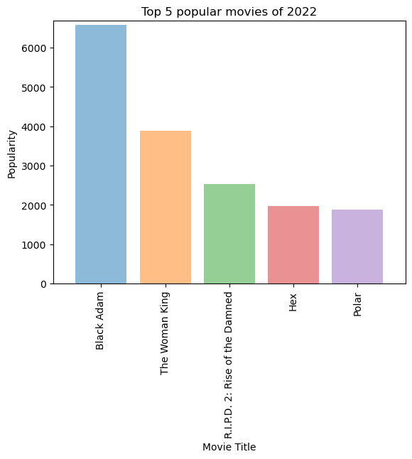
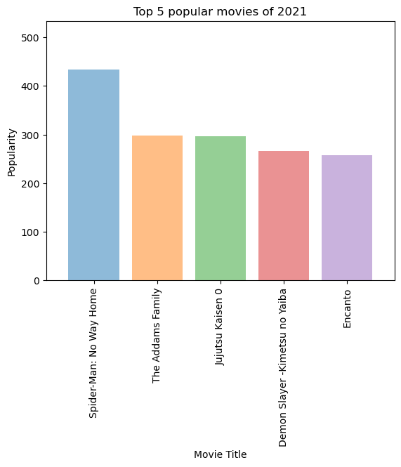
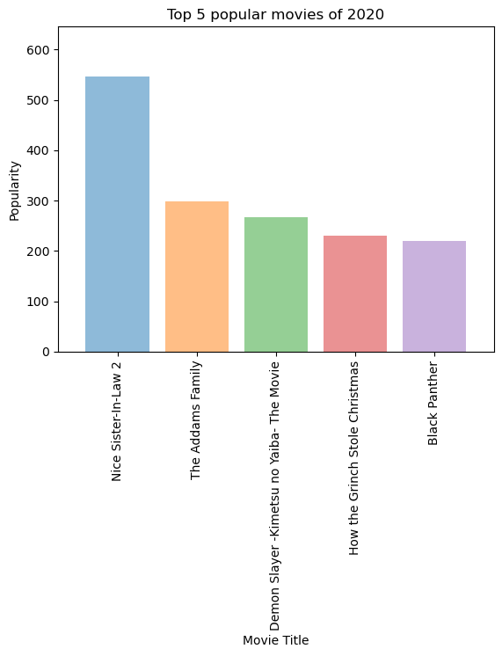
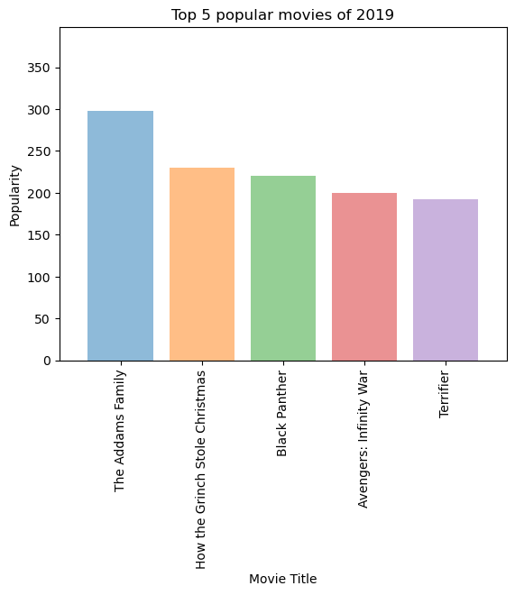
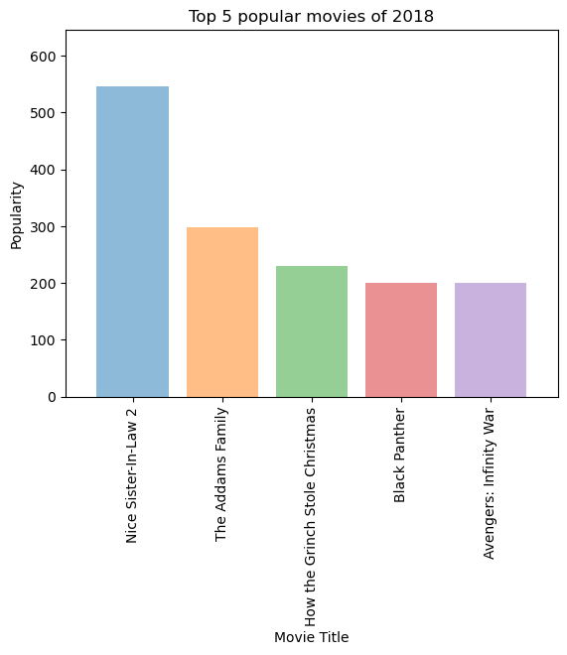
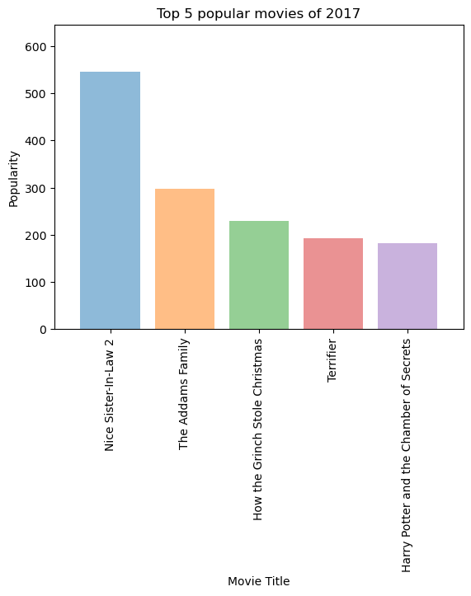
Top 5 Popular Movies
2017-2022
Movies which are consistently in Top 5 .
The Adams family 2017-2021.
How the Grinch stole Christmas 2017-2020.
Black Panther 2018-2020
Black Adam is leading in year 2022.

Slide 7
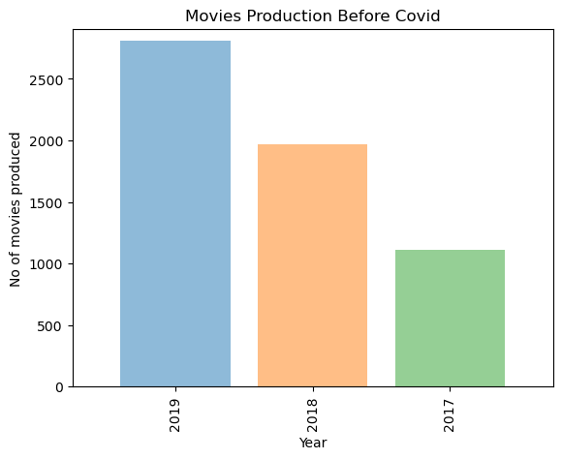
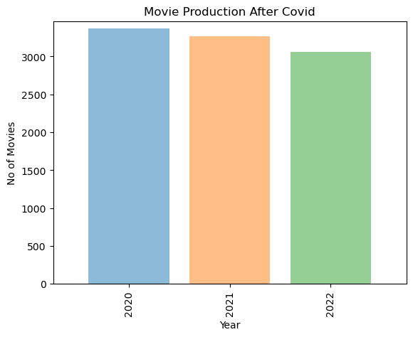
Movies Produced Before and After Covid-19
Movies Produced Before Covid -19
From Year 2020-2022
Movies Produced After Covid -19
From Year 2020-2022

Slide 8
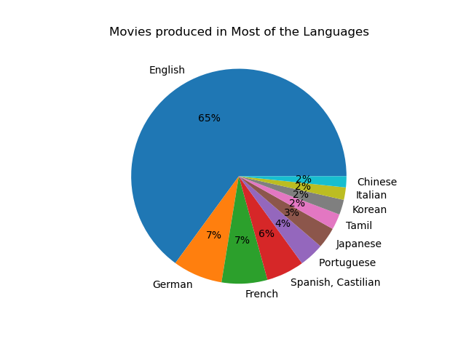

Movies Produced in Most Languages.
English
German
French
Spanish
Portuguese
Tamil
Korean
Italian
Chinese

